Slide 1
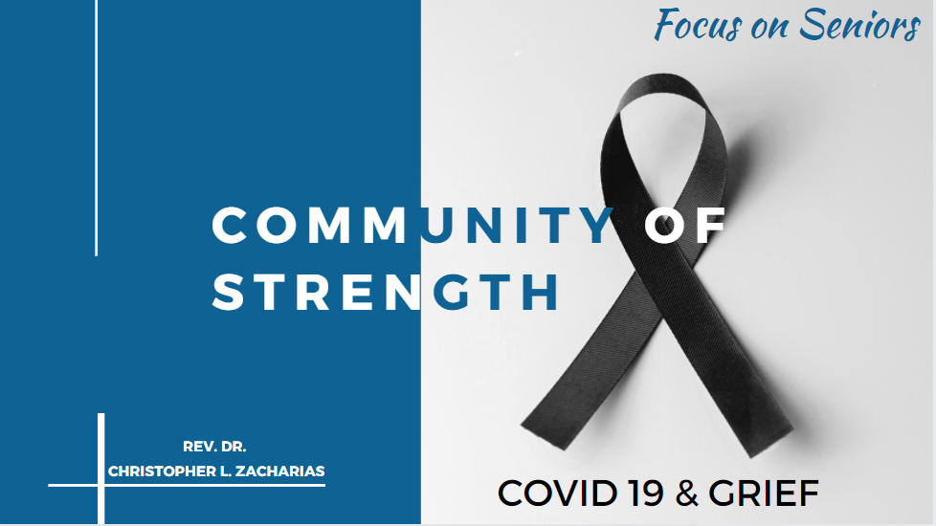

Slide 2

GRIEF
/ɡrēf/
deep sorrow, especially that caused by someone's death.

Slide 3


YOU…
The Affects & Effects of
COVID-19

Slide 4

You Can Recover!
You Can Overcome!
Increased Anxiety
Increased Loss
Increased Low Self-Esteem
Increased Fear
Increased Worry

Slide 5
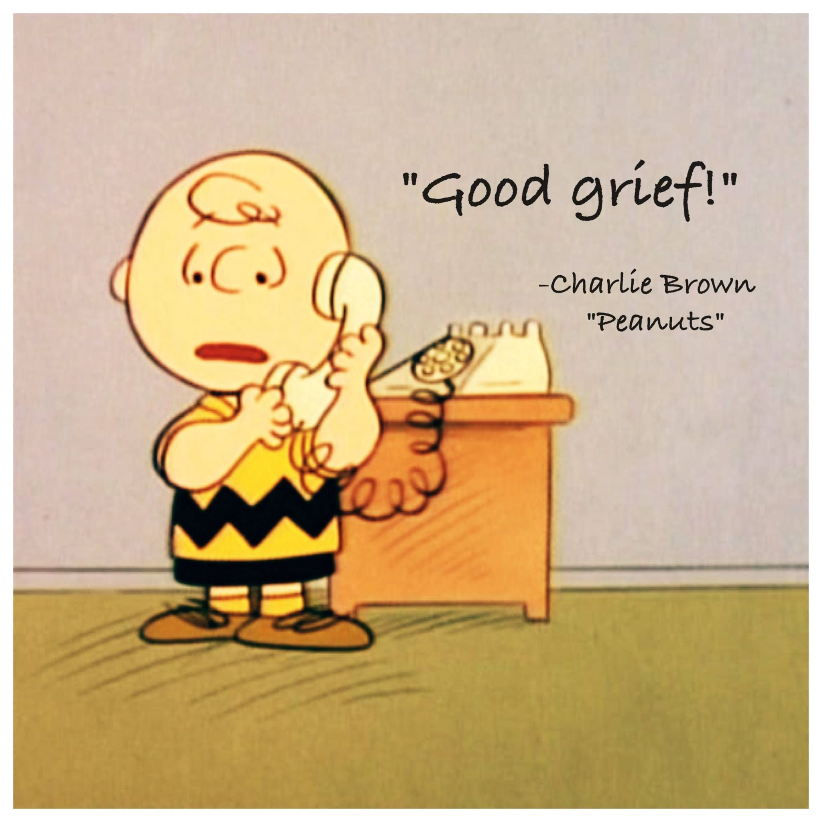
COVID-19 & GRIEF COPING METHODS
ACKNOWLEDGE
  Don’t deny yourself the freedom of expression (verbally or emotionally)
  Find ways to express your grief.
  Sharing your thoughts with trusted individuals who won’t judge you or try to diagnosis you
  A good venting session can go a long way.

Slide 6
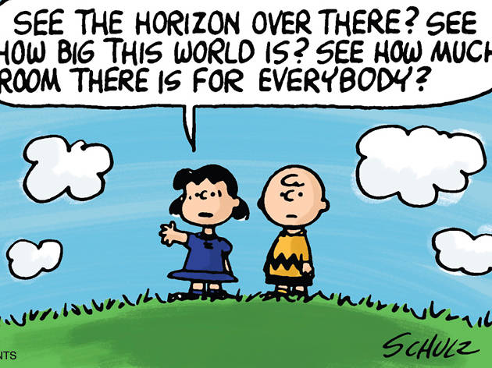
COVID-19 & GRIEF COPING METHODS

Slide 7

COVID-19 & GRIEF COPING METHODS
REJUVENATE
  What you love to do… Arts, gardening, writing, talking to friends or family, cooking, music or other creative practices of choice.
  Pamper yourself - Mind Body and Soul
  Do things that Revive You.
  Focus on activities that ignite Self-Care

Slide 8
COVID-19 & GRIEF COPING METHODS
RE-CONSIDER
Developing new daily routines
Stay connected with your loved ones
Don’t wait for the holidays to get together with family and friends apart from you.
Schedule more gatherings – not related to a loss of something or someone
Consider interacting through phone calls and video technology that allow for having fun, fellowship and togetherness

Slide 9

COVID-19 & GRIEF COPING METHODS
RE-ENGAGE
With Small group gatherings of support
Seek out grief counseling or mental health
services, support groups, or help hotlines
Seek spiritual support from faith-based organizations or simple meditation practices
Join small exercise groups, water aerobics, walking, board games, arts & crafts
Seek support from other trusted community leaders and friends
Covid-19 has caused us to isolate – don’t continue to be isolated
Invigorate yourself with others

Slide 10

COVID-19 & GRIEF COPING METHODS
RE-ESTABLISH
-
More Lasting Memories
Invite people to call you or host conference calls with family members and friends
Develop a virtual memory book, blog, or webpage to remember your loved one, and ask family and friends to contribute their memories and stories
Take part in an activity, such as planting a tree or preparing a favorite meal
Ask for help from others

Slide 11

COVID-19 & GRIEF COPING METHODS
RE-CONDITION
Your Strength – Stay Connected
  If you are worried about future losses, try to stay in the present and focus on aspects of your life that you have control over right now (Serenity Prayer)
  Continue to build a community of support around you and for your wellbeing
  Support Yourself by being Supported

Slide 12
HELPFUL RESOURCES
YOU ARE NOT ALONE
SEEK HELP
DC Department of Aging and Community
Living https://dacl.dc.gov/
DC Department of Behavioral Health
https://dbh.dc.gov/service/adult-services
Capital Caring Health
https://www.capitalcaring.org/get-help/our-services/grief-support/
Christians United Ministries
https://www.christiansunitedministries.org/
about/
Wendt Center for Loss and Healing
https://www.wendtcenter.org/about-grief/
Access Health Services
http://www.accesshealthservices.org/behavioral-health-and-wellness-services/behavioral-health-services
(202) 724-5626
(703) 360-9088
(202) 673-2200
(202) 624-0010
(202) 327-8294
(410) 244-1099

Slide 13


Slide 14


